Slide 1
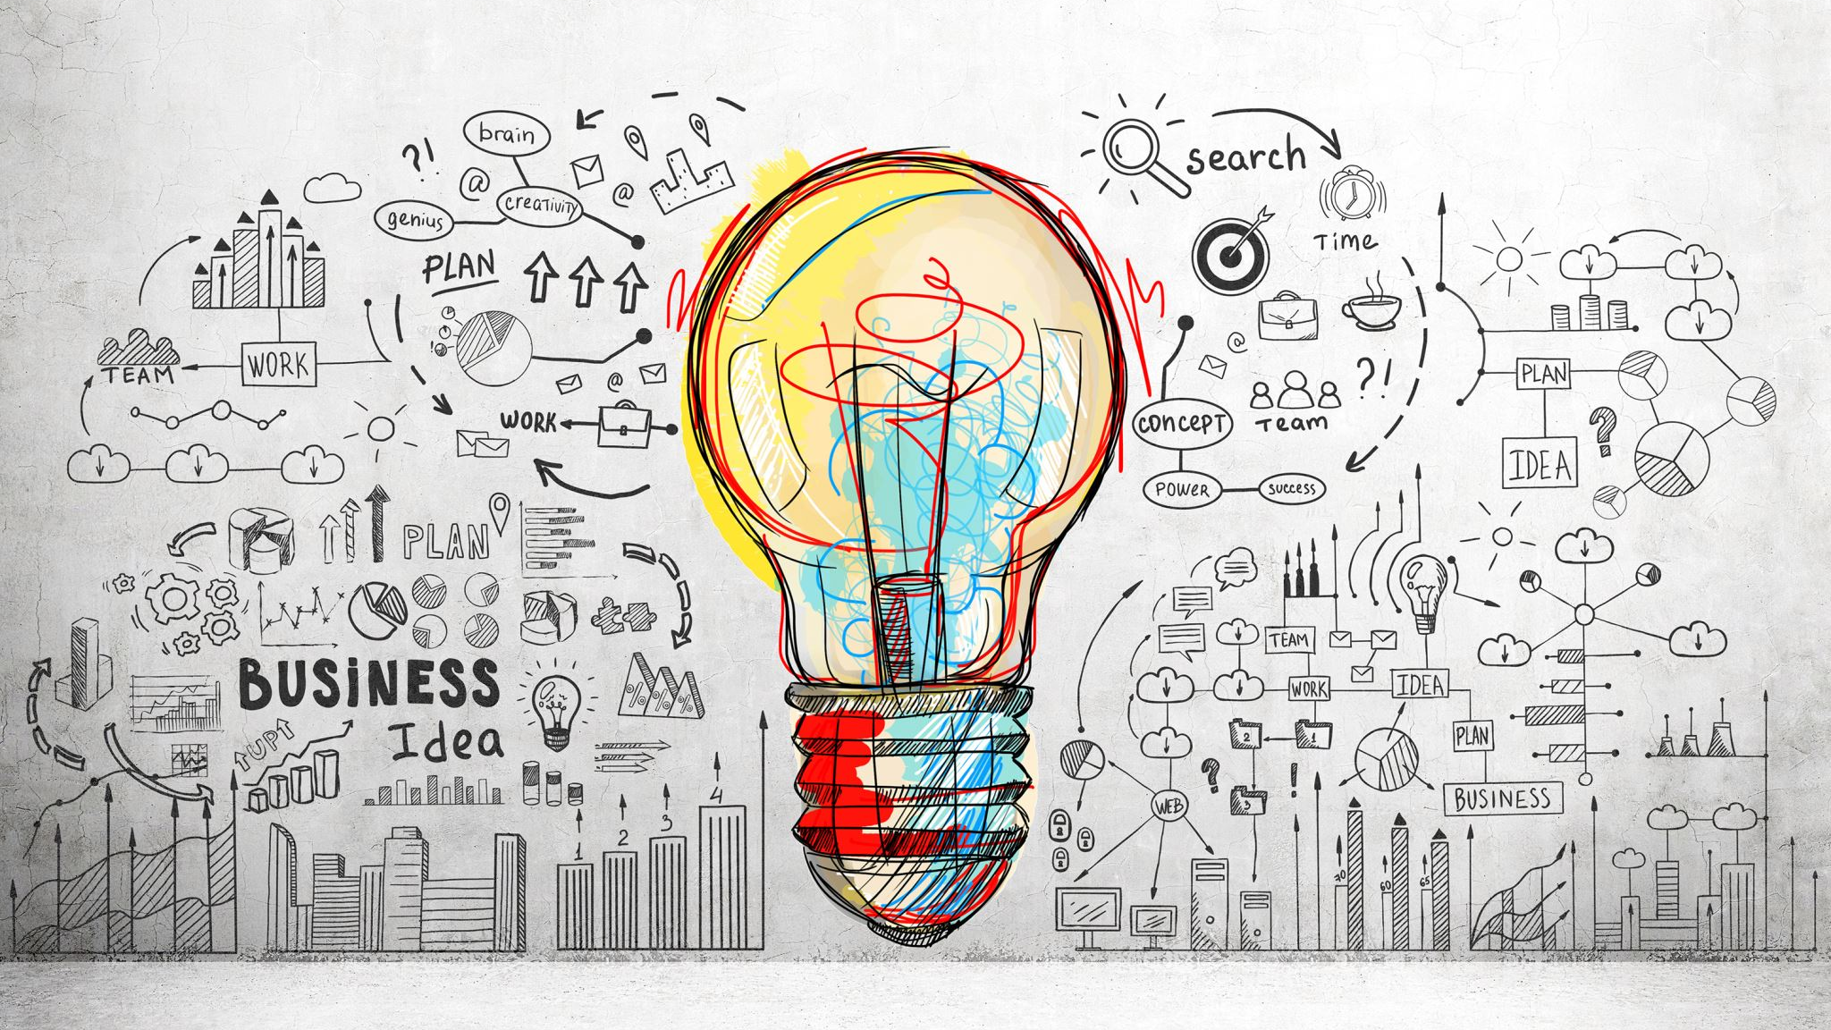
Asif Sharif Akash 20-42647-1 American International University-Bangladesh Dept. of CSE

Slide 2
Table of Content
Affordance
Visibility
Mapping
System Image
Gulf of Execution
Gulf of Evaluation

Slide 3

Affordance

Slide 4
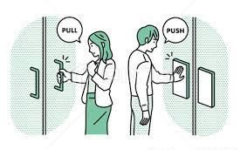
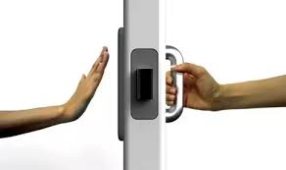
Affordance
Affordance is perceived and actual properties that indicate how something could be used, which can function as a useful conceptual model.

Slide 5
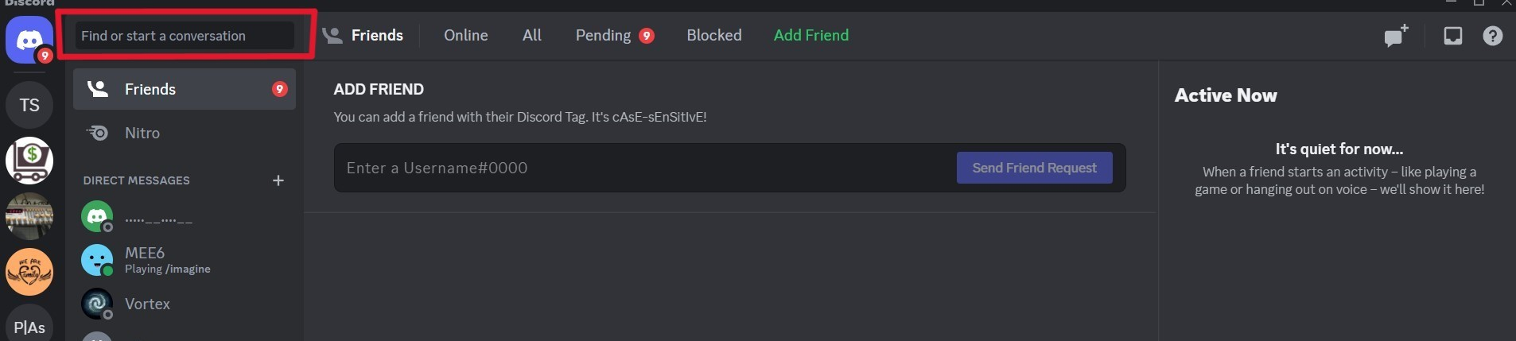
Affordance issue with Discord
Checking out the section called "Find or start a conversation" disappoints me because I thought it could use my voice as input and connect to AI or a search bar. There, nothing similar occurs; instead, it views the channel.

Slide 6

Visibility

Slide 7


Visibility
The basic concept of visibility suggests the more visible an element is, the chances it is that users will be familiar with it and understand how they can use it. A system with strong visibility allows the user to change goals into actions with simplicity.

Slide 8
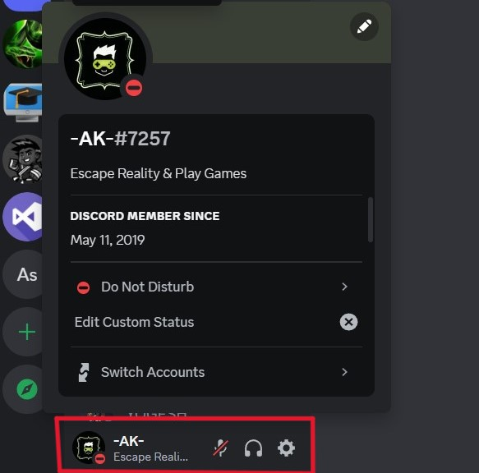
Visibility issue in Discord
The user profile or settings icon is typically displayed in the right top corner of every program software, but in Discord it is placed at the left bottom corner. Therefore, it won't be obvious to a first-time user because they won't know where to find the settings icon.

Slide 9

Mapping

Slide 10
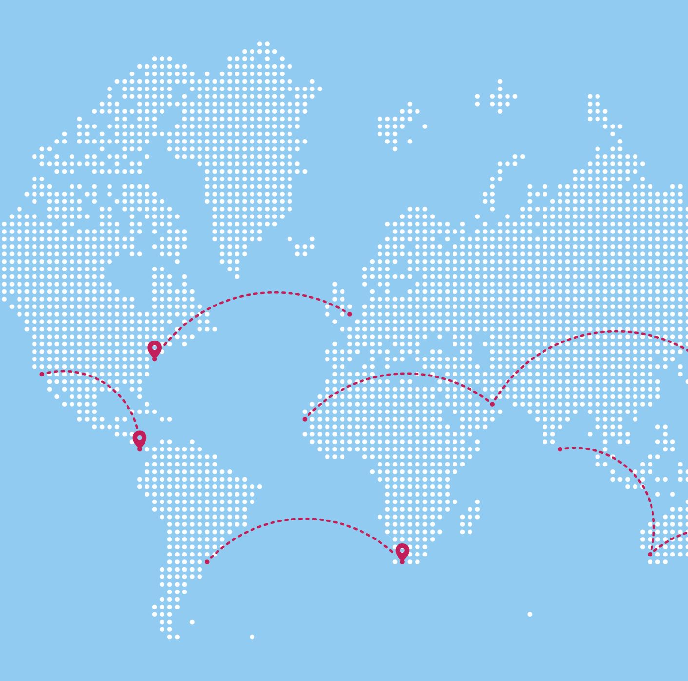
Mapping
The relationship between controls and their effects is known as mapping. Natural mappings that make use of physical analogies or customs from culture are good mappings. As a result, they are simple to understand, remember, and enable better accessibility.

Slide 11
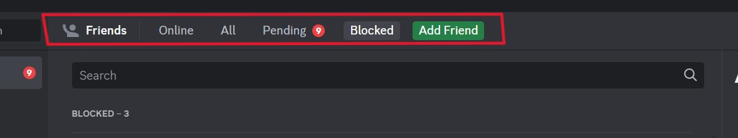
Mapping issue in Discord
There are tabs in Discord that show online friends, all friends, pending requests, and blocked users, however there is still a friends tab. This friend tab, like the all tab provides a list of friends. So, I believe there is a mapping problem over here.

Slide 12

System Image

Slide 13
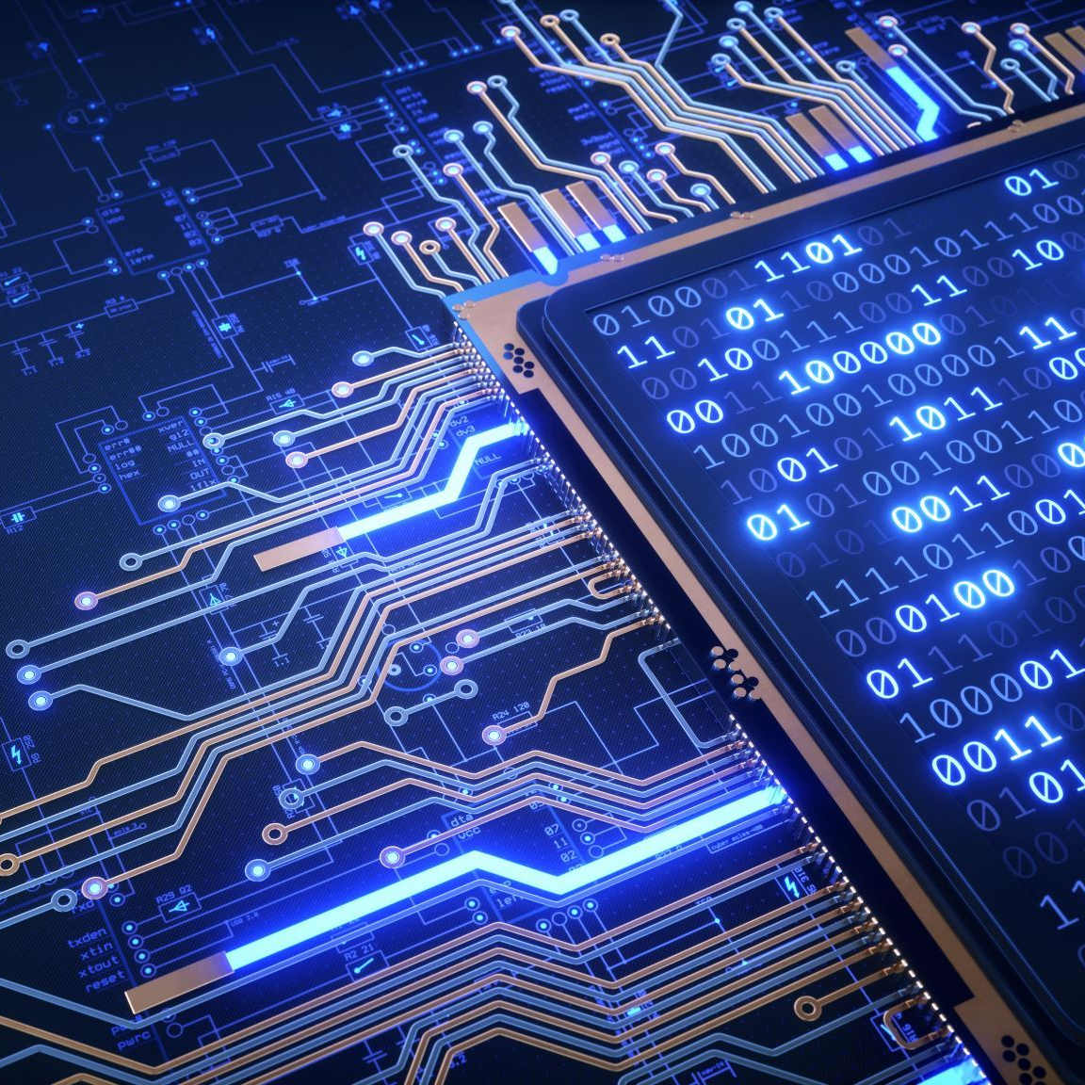
System Image
The system image is the visible part of a device that includes the physical structure, documentation, and instructions via which the design can communicate with the user.

Slide 14
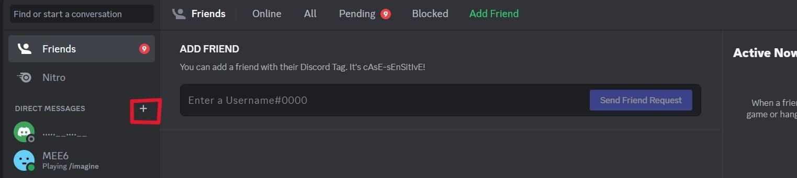
System issue in Discord
There is a plus(+) icon in Discord to create a DM direct message to a friend, which is unclear because it might also mean add a new friend to a new user.

Slide 15

Gulf Of Execution & Gulf of Evaluation

Slide 16
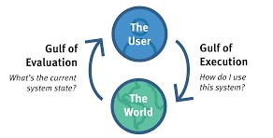
Gulf Of Execution & Gulf of Evaluation
Gulf of Execution: The degree of ease with which a user can grasp the current state of a system is determined by how well the system allows someone to accomplish their desired activities directly.
Gulf of Evaluation: To what extent does the system deliver a visible state that is directly perceived and interpretable in terms of the user's intentions and expectations

Slide 17
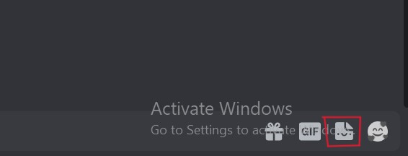
Gulf Of Execution & Gulf of Evaluation issue in Discord
I assumed in Discord the button displayed was for attaching papers or sharing. However, after clicking, it is possible to send GIFs, stickers, and emoji. As a result, there is a contradiction between user intent and expectations over here.

Slide 18
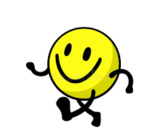
Thank You
Asif Sharif Akash
20-42647-1

